Slide 1
Lecture 3: Random number generation

Slide 2
Pseudorandom numbers
Pseudo Random Number Generators:
Create random numbers using a mathematical algorithm
Classic examples: Congruential generators
Come as embedded functions in software or can be linked as separate objects to the program code.
The numbers are not truly random; attention must be made to the type of application.

Slide 3
First step: Generating U[0,1]
Linear congruential generator
Define a sequence {x_{k} } of integers according to
where x₀ is called seed , “mod m” means that x_{k} is the remainder after division by m
The result is an integer in the interval [0, m – 1]
a and c are constants in [0, m), need to be carefully selected
To obtain U[0,1] , x_{i} are scaled, i.e.
x_{i}:= x_{i}/m

Slide 4
First step: Generating U[0,1]
Generated numbers will get into a “loop” with a certain period
Example:
Let x₀ = a = c = 7 and m = 10
➔
The period is thus 4 in this case

Slide 5
First step: Generating U[0,1]
Comments:
Obviously, period can not be larger than m
Period and other constants should be carefully chosen, m is typically very large
Seed defines the sequence of random numbers, if seed is fixed by program – same sequence will be produced
Other methods for generating U[0,1] are available (i.e. generalized feedback shift register)

Slide 6
Generation U[a,b]
U(0,1) can be transformed to U(a, b):
U can also be transformed to discrete uniform distribution on the integers (1, …, n ) by
where [⋅] depicts the integer part.
Question and exercise:
Why do we need to add “1”?
How can U be transformed to a random variable Y with a discrete uniform distribution on the integers (50, 55, 60) ?

Slide 7
Generation of nonuniform random numbers
U(0,1)
Let U be a random variable uniformly distributed on (0,1)
Let F_{U} be its cumulative distribution function, i.e.
The probability density function (pdf) of U is

Slide 8
Inverse CDF method
Let X be a random variable with CDF F_{X} .
Set where U is U(0,1)
The CDF of Y is now
as 0 ≤ F_{X} (y) ≤ 1 and F_{U} (u) = u for 0 ≤ u ≤ 1
➔ Y has the same probability distribution as X !!

Slide 9
Inverse CDF method
Thus, if U is U(0,1) then a realization of a random variable X with CDFF_{X} can be obtained by
provided F_{X}⁻¹ can be evaluated
The realization U of course comes from a RNG

Slide 10
Inverse CDF method
Example
Let X be exponentially distributed, i.e. with pdf
➔
for x ≥ 0 [F_{X} (x) = 0 for x < 0]

Slide 11
Inverse CDF method
Example(cont.)
To find F_{X}⁻¹ solve for x the equation
Thus the transform from U to X becomes

Slide 12
Inverse CDF method
Inverse CDF method – discrete variables
Define distribution P(X=x_{i})=p_{i}
Generate U from U(0,1)
If U≤p₀, deliver X=x₀
If U≤p₀+ p₁, deliver X=x₁
…
Repeat procedure from step 2

Slide 13
Inverse CDF method
When the inverse cumulative distribution can be explicitly derived ➔ No problem!
When not ➔ Numerical solution necessary ➔ Usually time-consuming
Unfortunately, situation 2 is quite typical, ex.: normally distributed random variables

Slide 14
Generating N(0,1)
Assume
Θ ε U(0, 2π)
D ε U(0,1)
Algorithm 1
Generate D and Θ
Generate X₁ and X₂ as
X₁ and X₂ are independent and normally distributed (see proof…)

Slide 15
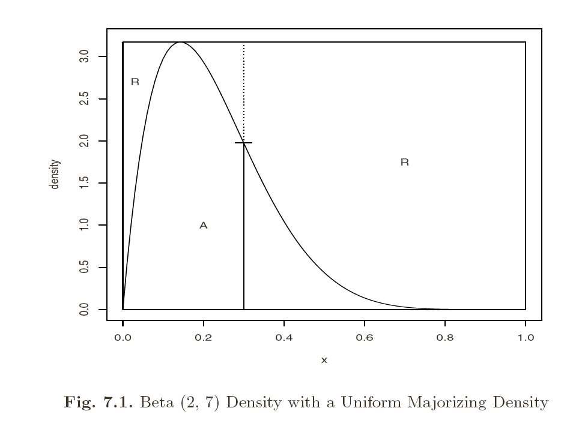
Acceptance/rejection methods
Idea: to generate Y with PDF f_{y} similar to some known PDF f_{x}
Requirement: There should exist constant c such that
cf_{Y}(x) majorizing density,
proposal density
f_{X}(x) target density

Slide 16
Acceptance/rejection methods
Algorithm
Generate Y from distribution with density f_{Y}
Generate U from U(0,1)
If , take Y else return to step 2
It can be seen that variables obtained are from f_{X} (see proof…)
The value of c should be as small as possible (minimize the frequency of rejection)
The method works for multivariate random cases, but the rejection proportion can be high (curse of dimensionality)

Slide 17
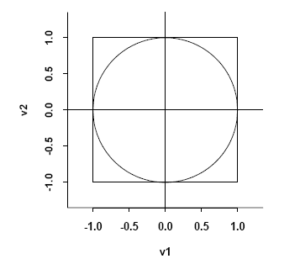
Acceptance/rejection methods
How to use in generation N(0,1):
Computing sin, cos is time consuming.
Step 1:
To generate multivariate uniform (V₁, V₂)
density on the circle,
consider (V₁, V₂) – uniform on rectangle
and Use accept/reject method

Slide 18
Acceptance/rejection methods
Step 2
Consider R and Θ such that V₁=RcosΘ, V₂=RsinΘ ->
Normal distribution can be obtained (show..)

Slide 19
Generating multivariate normal
Acceptance/rejection is difficult to apply
Difficult to determine majorizing density
High rejection rate
Suppose we need to generate N(μ,Σ):
Take i.i.d. N(0,1) sequence X=(X₁,…X_{n})
Compute Cholesky factor or matrix square root, i.e. matrix A: AA^{T}= Σ
Compute Y as μ+AX
Observe: EY= μ, cov(Y)=AA^{T}

Slide 20
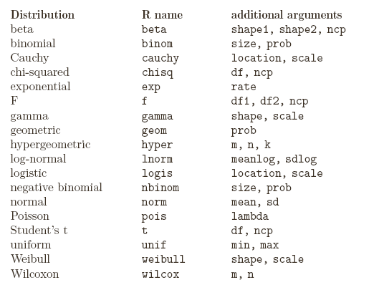
Random numbers in R
Use d for density p for CDF q for quantiles and r for simulation:
(ex: rnorm pnorm dnorm qnorm)

Slide 21
Recommended reading
Chapter 7.1-7.3

